Slide 1
Oct – Dec 2025

Slide 2

Biggest Challenge
Touchstone – Testing phase / getting it ready to go live
WHAT: Customer was still swapping out content while we were working on the site.
WHY:
Issues logged due to the change in content + due to errors while fixing something else.
Deadlines for the customer to upload content kept getting pushed back.
HOW:
Pushed back when the customer requested a change that went against the design.
Separated each issue on Trello and assessed each individually.
NEXT TIME:
Request completed content before building.

Slide 3

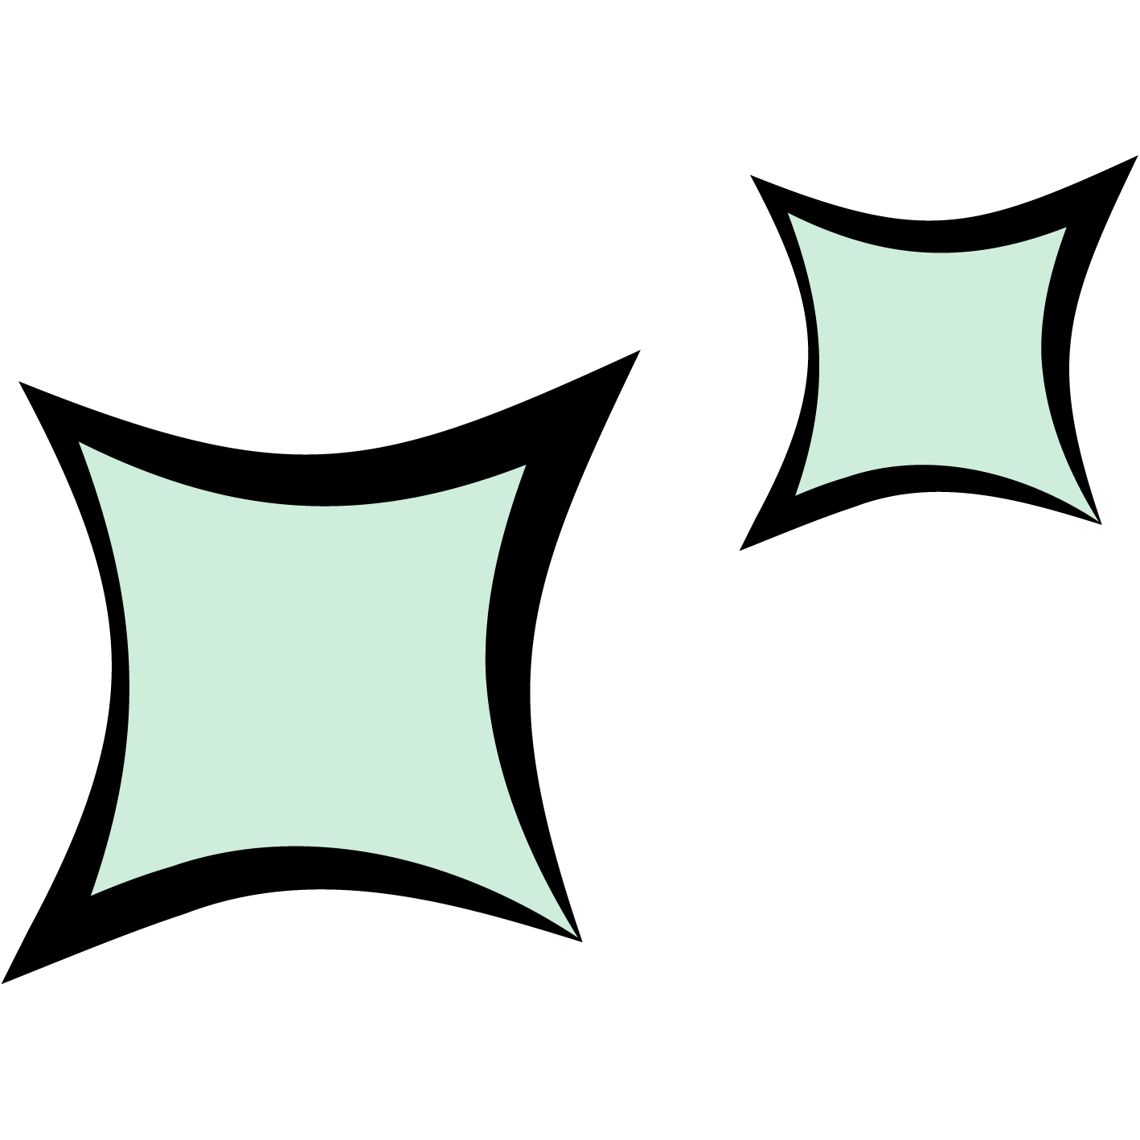
Biggest Success
WHAT:
New Website Energizers Website!
WHY:
Built using repeated sections across site
Sections were already responsive
Consistency across the site, relatively quick build for the size.
LEARNED:
We can build websites faster by using repeated, responsive sections.
Have implemented this into the design and build process.

Slide 4
Main Focus
Getting Sites Live
Simply The Best Events
My Modern Office
ASP Electro – Technology
Cherwell Water Utilities – Backflow
Starting Build On
Adam Aaronson
McCarty Hire
Fire & Electrical Safety

Slide 5
THANK YOU.

